Slide 1
CS7641 Machine Learning Goodreads Recommendation System Project Proposal
Team 23
Sanjana Garg, Tianyi Liu, Santyblesson Pushparaj, Shashank Rajkumar, Sagarika Srishti

Slide 2
Video Link
https://github.com/sanjanag/book-recommendation/blob/master/ProjectProposal/ProposalTeam23.mov

Slide 3

Introduction/Background
Large scale Recommender Systems
Netflix
YouTube
Amazon
Recommender System approaches
Collaborative filtering
Content-based filtering
Knowledge based
Hybrid approaches
What is Goodreads?
Notes:
Many companies today, such as Amazon, Netflix, BestBuy, rely on Recommender Systems to launch targeted marketing campaigns and make customized suggestions to their users. According to a McKinsey study [8], 35% of purchases on Amazon and 75% of content watched on Netflix are driven by algorithmic recommendations
Recommender systems employ different approaches such as collaborative filtering, content-based filtering, a hybrid or both, or knowledge-based systems to generate recommendations for a user. They are a great alternative for search, and help users come across products (in our case, books) that they wouldn’t have found otherwise
Goodreads is a social cataloging website that allows individuals to search its database of books, annotations, quotes, and reviews.

Slide 4
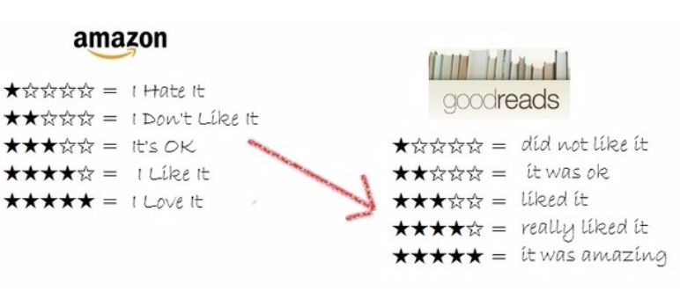
Problem Statement
Goodreads Recommendations
Recommend top N books based on prior user interactions with books
Predict book ratings given its attributes
Notes:
We want to work on the task of building a recommender system that does the following

Slide 5
Methodology
Datasets
Goodreads Dataset (UCSD)
2,360,655 books (1,521,962 works, 400,390 book series, 829,529 authors)
876,145 users; 228,648,342 user-book interactions in users' shelves
Supervised ML
Predict average rating of book
Linear Regression baseline
Neural Networks
Input features tweaking
Notes:
Goodreads Dataset is an anonymized dataset scraped in 2017, that contains information from users’ public shelves. It contains metadata of books, user-book interactions, book reviews
The first task of our project is to use supervised learning algorithms to accurately predict the average rating of a book. We plan to initially use linear regression as a baseline [1]. We also want to use a neural network to see if our performance improves [2].

Slide 6
Methodology
Unsupervised ML
Content-based filtering
Collaborative filtering
Evaluation
Root-Mean-Squared-Error (RMSE) for rating prediction algorithm
Normalized-Discounted-Cumulative-Gain for recommendation evaluation
Notes:
Content-based filtering
Content-based filtering makes recommendations to users based on their preferences for content.
Collaborative filtering
Collaborative filtering makes recommendations based on other users’ ratings along with the user in question.
Our experiments will involve performance assessments using classifiers for the prediction system and to contrast the two filtering methods in nsupervised ML for the recommender system.

Slide 7
Results and Discussion
Hypotheses:
Combination of metadata and text features gives superior results
Content-based filtering approach might be better at predicting individual user ratings since they are specific to a user
The collaborative filtering approach is more diverse than content-based filtering since it models user behavior instead of a specific user
Notes:
We expect to find that using both metadata and textual features will give a superior performance for the recommender system. We also expect to deduct that the content-based filtering approach might be better at predicting individual user ratings since they are specific to a user. The collaborative filtering approach is more diverse than content-based since it models user behavior instead of a specific user.
The objective of this project is to use machine learning models to first identify a personalized reading list and then predict the rating of books. Some potential difficulties could be caused by the computational complexity associated with neural networks. We also anticipate some challenges related to hyperparameter tuning for matrix factorization and our ability to handle first time users. Overall, we believe our project would help us explore various supervised and unsupervised learning techniques, and we believe we can build a robust system that is able to provide a personalized book recommendation system.

Slide 8
Thank You

